Slide 1
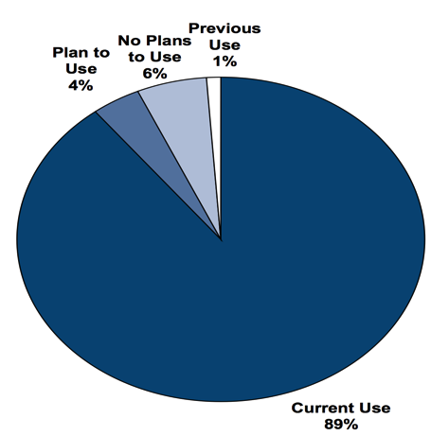
Mobile: Life Science Industry
Portable/Mobile Devices Used by Scientists
Mobile Marketing to Life Scientists
BioInformatics (August 2012)
70% smartphones/tablets*
*Life Scientists own/use smartphones/tablets at a higher rate than the general pop.

Slide 2
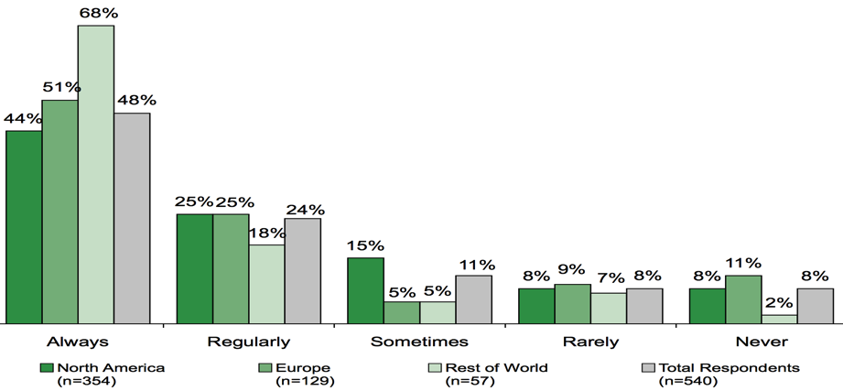
Mobile: Life Science Industry
Frequency with Which Scientists Use Mobile Devices to Support their Work in the Lab by Geographic Region
Mobile Marketing to Life Scientists
BioInformatics (August 2012)

